Slide 1
Pre-trained Large Language Models
CS 162: Natural Language Processing
Jia-Chen Gu
Course website: https://vnpeng.net/cs162_win24.html
syllabus,
announcements,
slides,
homeworks

Slide 2
Lecture Plan
Motivating model pre-training from word embeddings
Pre-training Model Architectures
Unidirectional
Independently Bidirectional
Bidirectional
Scaling Law for Language Models
Large Language Models and Beyond
Notes:
Here's the lecture plan today.
How the model performance changes with the increase of model size, and some associated factors like data size, training steps and so on.
Ongoing and active research on LLMs. The last part just a quick introduction of what's going on recently in NLP community, talking about were we are now and where we will go in the future.

Slide 3
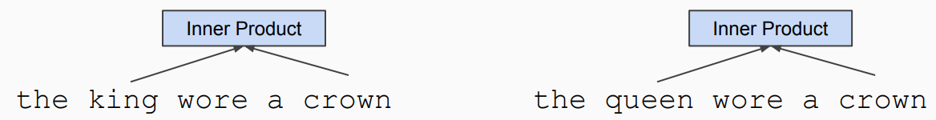
Word Embeddings
Word embeddings are the basis of deep learning for NLP
king queen
[-0.5, -0.9, 1.4, …] [-0.6, -0.8, -0.2, …]
Word embeddings (word2vec, GloVe) are often pre-trained on text corpus from co-occurrence statistics
Notes:
Let's start from word embeddings, which I believe has been introduced in previous lectures. They are the basis of DL for NLP.
We have a high-dimensional vector representation for each word. Through them we can capture the relationships between them.
These word embeddings are often pre-trained ...
For example, king is often associated with crown, queen is also often associated with crown. From large amount of texts, it can be inferred that king is closely related to queen in some dimensionality.

Slide 4
Contextualized Representations
Problem: Word embeddings are applied in a context free manner
open a bank account on the river bank
[0.3, 0.2, -0.8, …]
Solution: Train contextualized representations on text corpus
You shall know a word by the company it keeps
open a bank account on the river bank
[0.9, -0.2, 1.6, …] [-1.9, -0.4, 0.1, …]

Slide 5
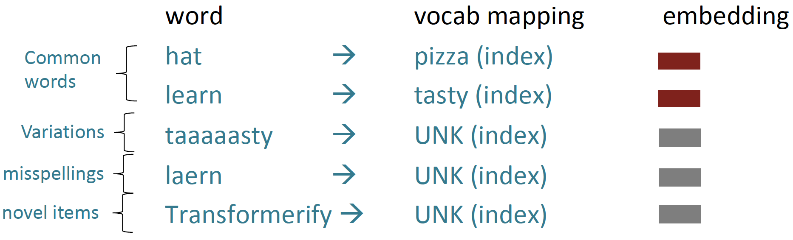
Word Structure and Subword Models
We assume a fixed vocab of tens of thousands of words, built from the training set.
All novel words seen at test time are mapped to a single UNK.

Slide 6
Byte-Pair Encoding (BPE)
learn a vocabulary of subword tokens, and each word is split into a sequence of known subwords at training and testing time.
Start with a vocabulary containing only characters and an “end-of-word” symbol.
Using a corpus of text, find the most common adjacent characters “a,b”; add “ab” as a subword.
Replace instances of the character pair with the new subword; repeat until desired vocab size.
Now a similar method (WordPiece) is used in pretrained models.
Rico Sennrich, et al. Neural Machine Translation of Rare Words with Subword Units. ACL 2016.
Notes:
Subword modeling in NLP encompasses a wide range of methods for reasoning about structure below the word level. (Parts of words, characters, bytes.)

Slide 7
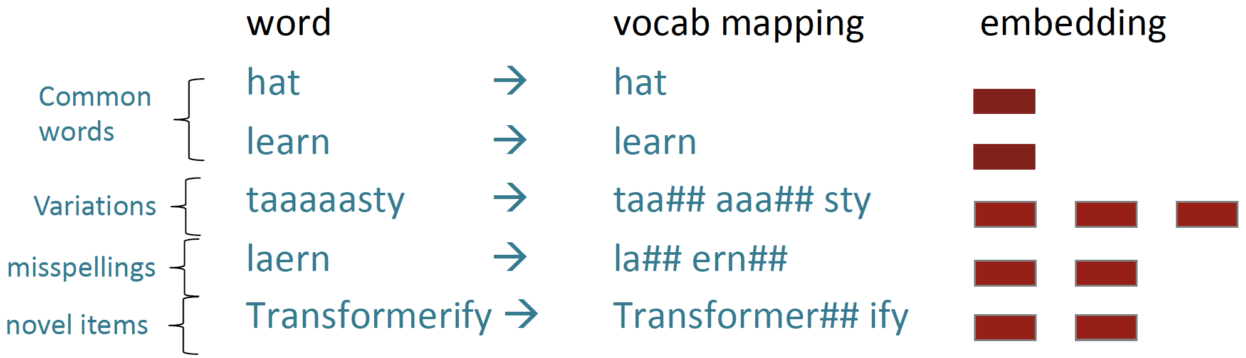
Word Structure and Subword Models
Common words end up being a part of the subword vocabulary, while rarer words are split into (sometimes intuitive, sometimes not) components

Slide 8
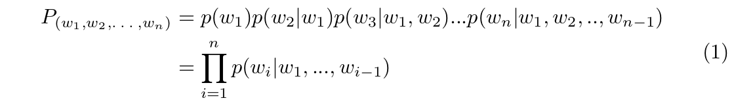
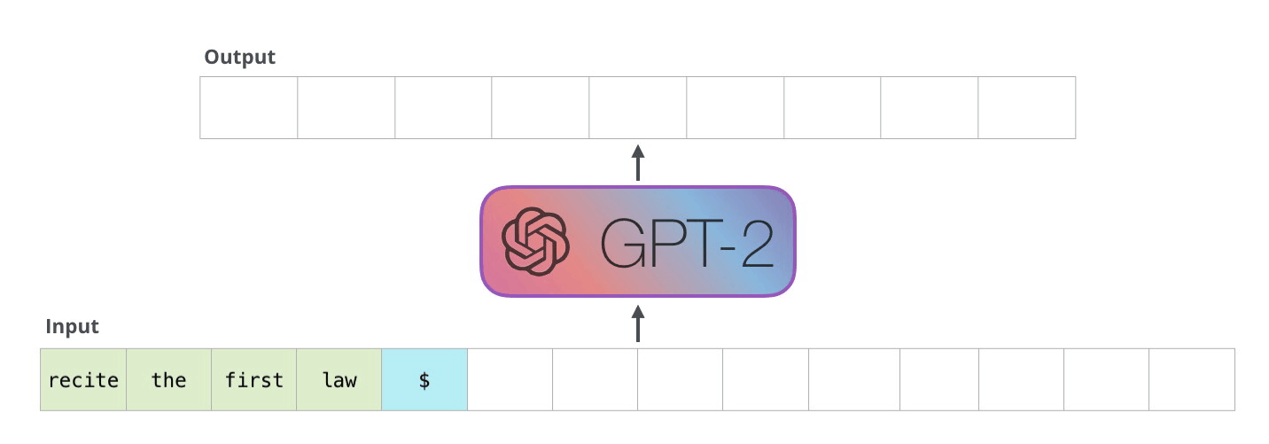
Language Model
Language modeling is the task of modeling the probability distribution of natural language text
The Illustrated GPT-2, https://jalammar.github.io/illustrated-gpt2/

Slide 9
Why Pre-training?
Given sufficient labeled data, supervised learning can be conducted smoothly by training and testing under similar distribution
What if we have a low amount of, or even no annotated data? Training a model initialized from scratch on a downstream task is not very powerful
Unlocked by self-supervised pre-training on a lot of unannotated data (e.g., Wikipedia or the web) and then fine-tuning it to the downstream task

Slide 10
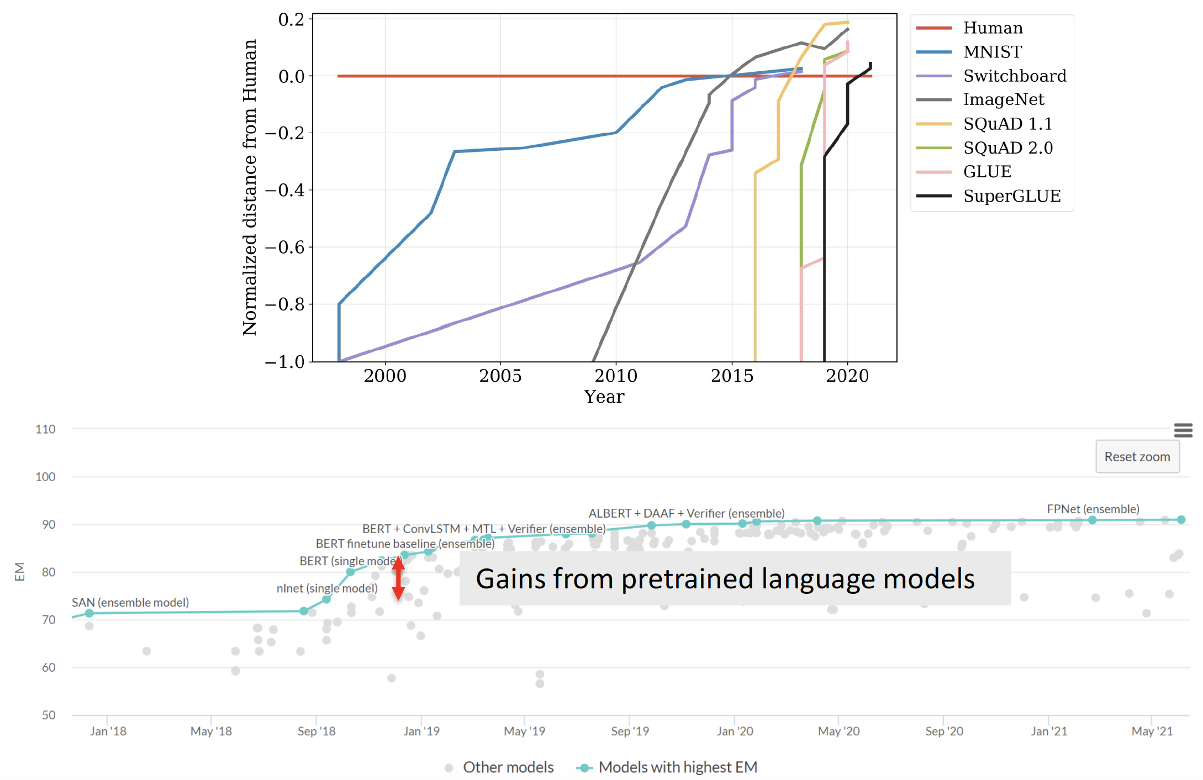
The Pretraining Revolution
Pretraining has had a significant and tangible impact on how well NLP systems work

Slide 11
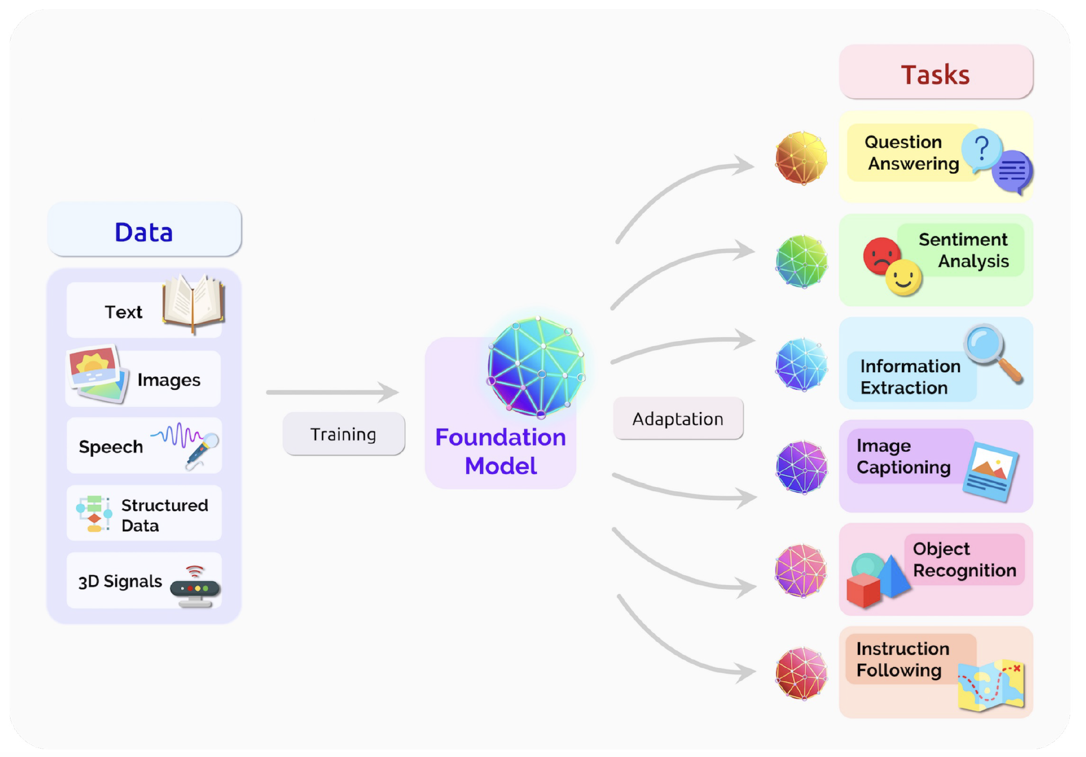
Scale Unsupervised Learning and Generalize
Unsupervised Learning: not use labeled data, otherwise cannot scale
Massive Data: large amount of data to capture semantics
Downstream Task: can generalize to multiple tasks by fine-tuning

Slide 12
Lecture Plan
Motivating model pretraining from word embeddings
Pre-training Model Architectures
Unidirectional
Independently Bidirectional
Bidirectional
Scaling Law for Language Models
Large Language Models and Beyond

Slide 13
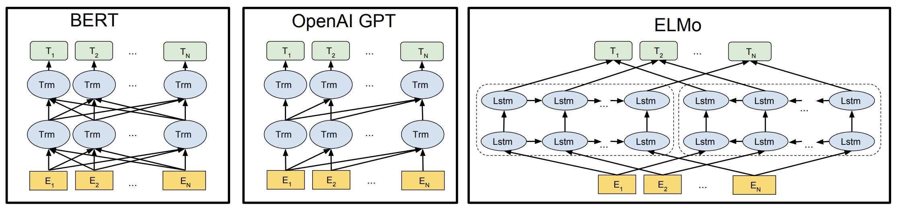
Pre-training Model Architectures
Bidirectional Unidirectional Independently bidirectional
Jacob Devlin, et al. BERT: Pre-training of Deep Bidirectional Transformers for Language Understanding. NAACL 2018.

Slide 14
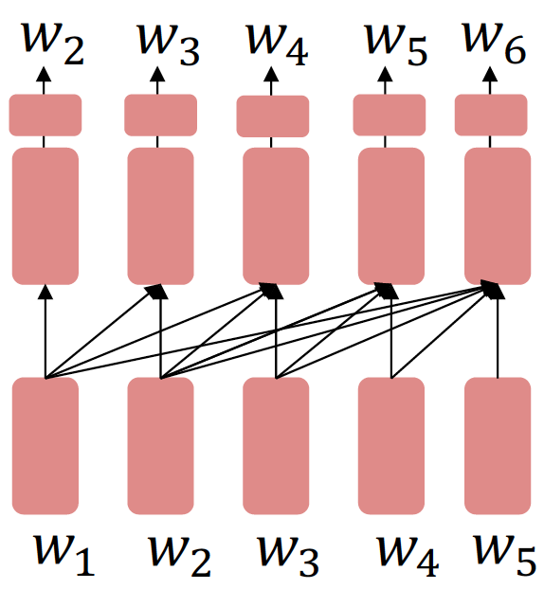
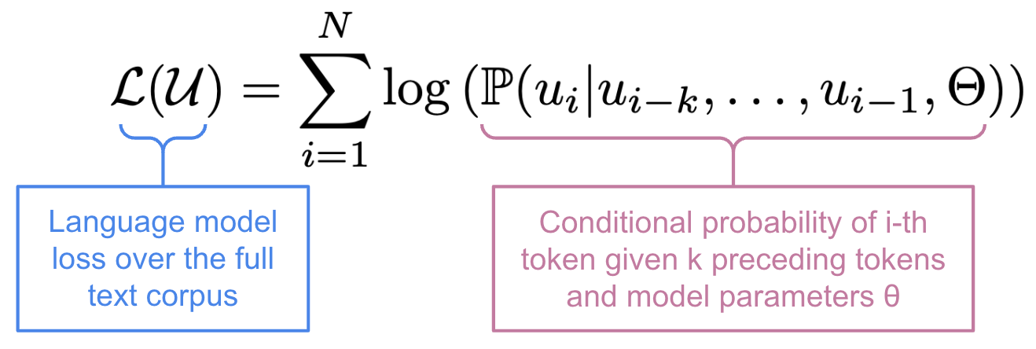
Unidirectional Pre-training
Decoder-only and cannot condition on future words
Improving Language Understanding by
Generative Pre-Training (GPT), OpenAI, 2018

Slide 15
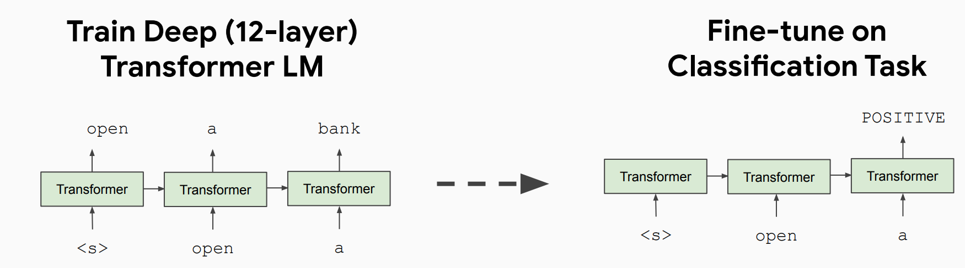
GPT Pre-training and Fine-tuning
After pre-training, finetune by training a classifier on the hidden state of the last word
Paper title: Language Models are Few-Shot Learners, A.K.A. GPT-3. Neurips 2020, best paper award.

Slide 16
GPT Technical Details
GPT in 2018 was a big success in pre-training a decoder!
Transformer decoder with 12 layers, 117M parameters
768-dimensional hidden states, 3072-dimensional feed-forward hidden layers
Byte-pair encoding with 40,000 merges
Trained on BooksCorpus: over 7000 unique books.
Contains long spans of contiguous text, for learning long-distance dependencies.

Slide 17
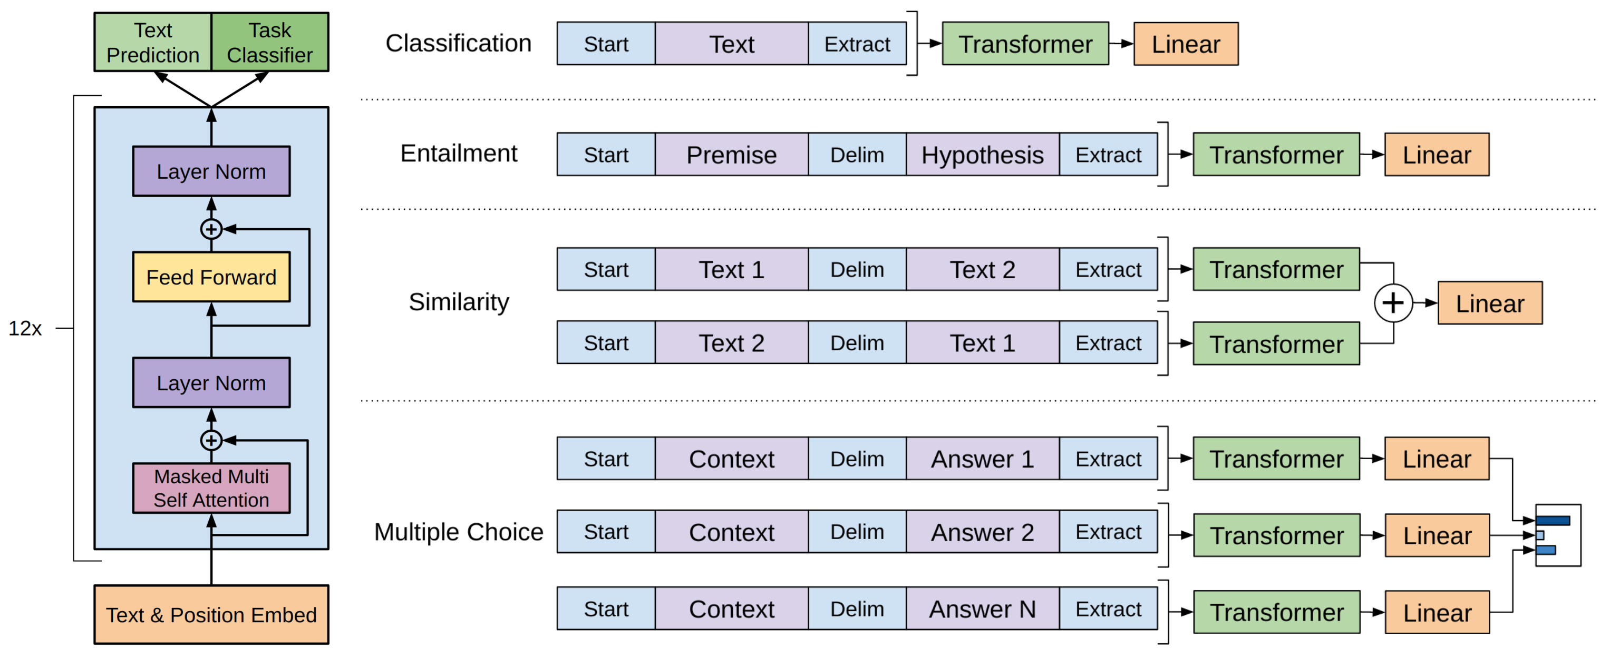
Fine-tuning GPT for Downstream Tasks

Slide 18
GPT for Natural Language Inference
How to format inputs to the decoder for finetuning tasks?
Natural Language Inference: Label pairs of sentences as entailing/contradictory/neutral
[START] The man is in the doorway [DELIM] The person is near the door [EXTRACT]
The linear classifier is applied to the representation of the [EXTRACT] token

Slide 19
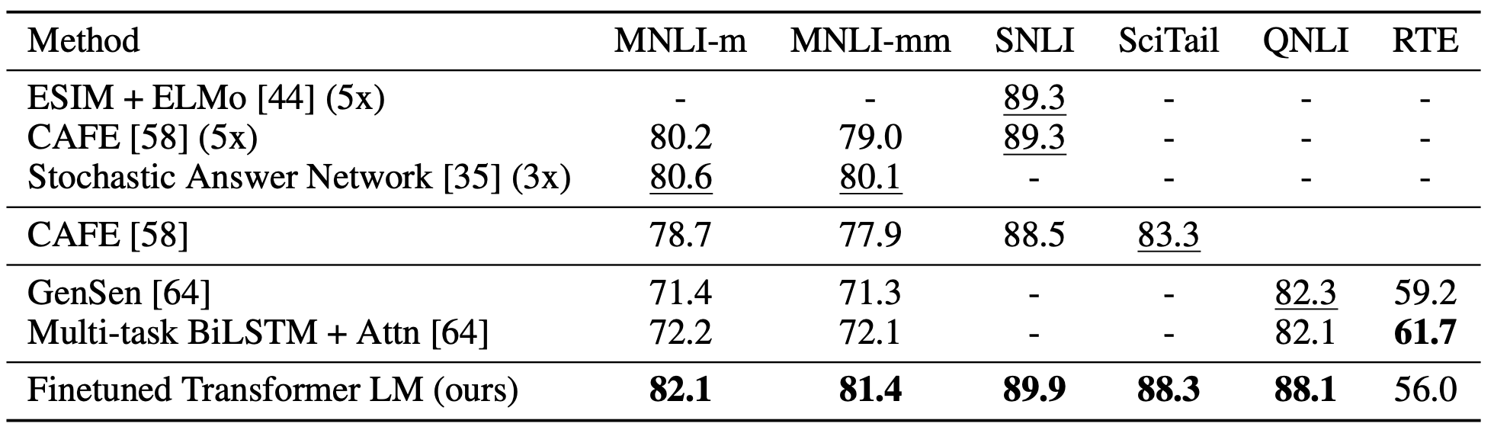
GPT Results on NLI
GPT results on various natural language inference datasets

Slide 20
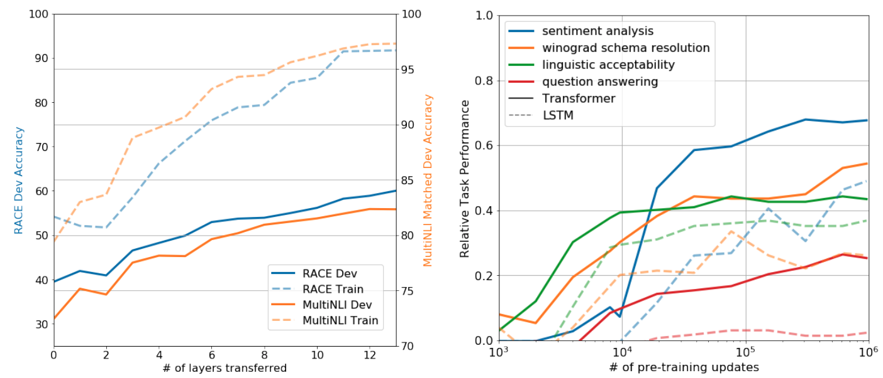
Effect of Pre-training in GPT
As more layers are transferred, performance improves on RACE (a large-scale reading comprehension dataset) and MultiNLI
Zero-shot performance of Transformer vs. LSTM as a function of the # of pre-training updates

Slide 21
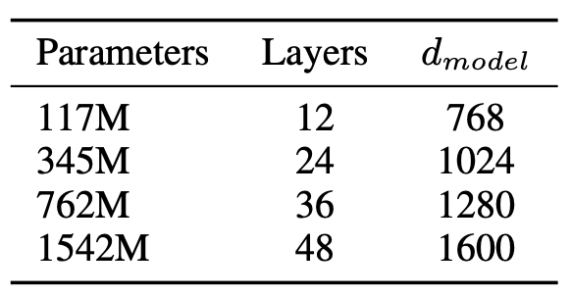
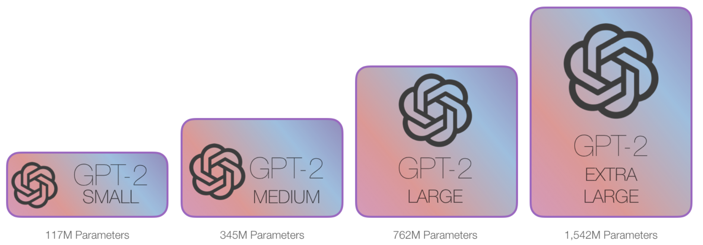
Stronger GPT-2
Alec Radford, et al. Language Models are Unsupervised Multitask Learners. OpenAI 2018.

Slide 22
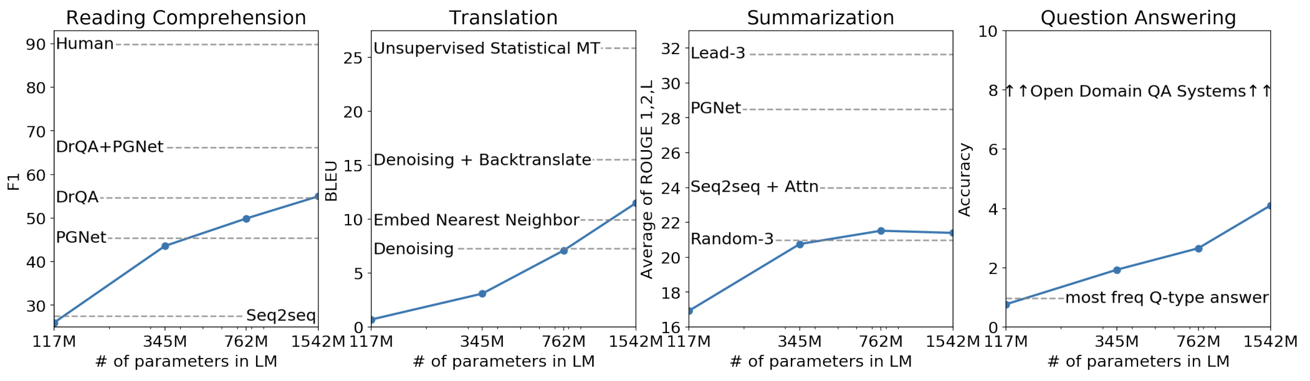
GPT-2 Results
GPT-2, a larger version (1.5B) of GPT trained on more data, was shown to produce relatively convincing samples of natural language
Alec Radford, et al. Language Models are Unsupervised Multitask Learners. OpenAI 2018.

Slide 23
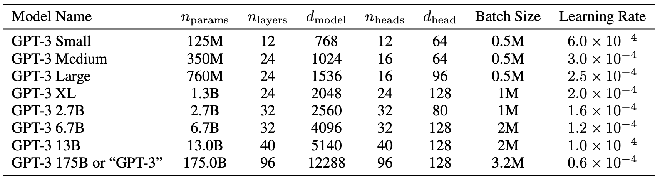
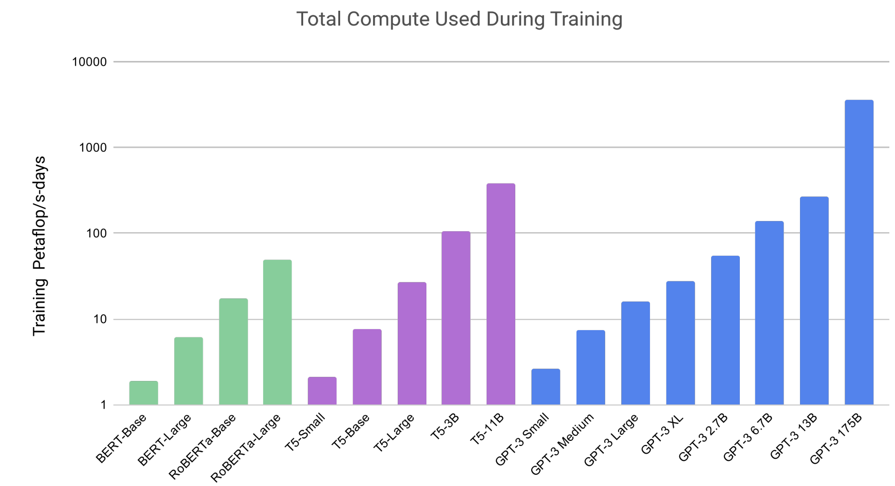
Stronger GPT-3
8 varying sizes
Total compute used during training
Tom B. Brown, et al. Language Models are Few-Shot Learners. NeurIPS 2020.

Slide 24
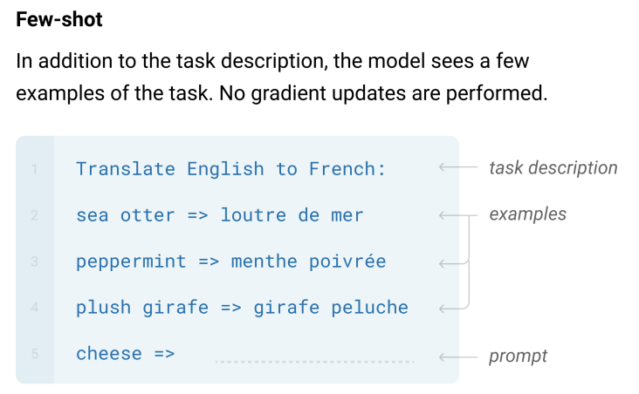
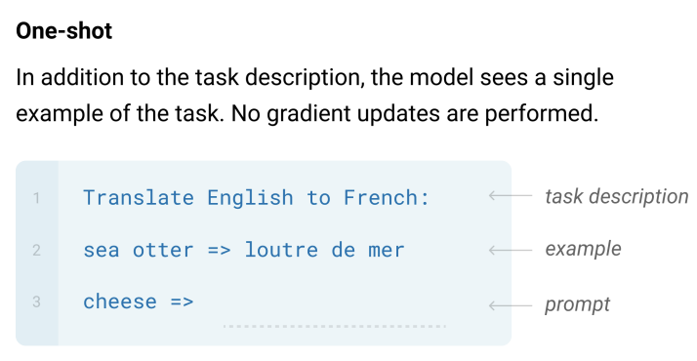
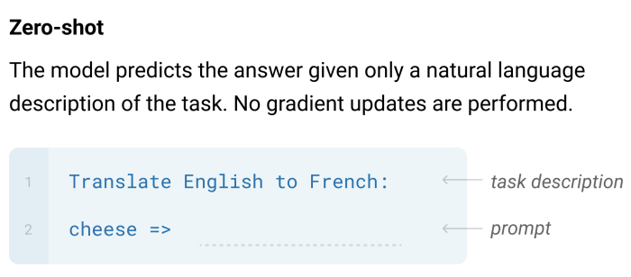
GPT-3 with In-context Learning
Large language models seem to perform learning without gradient steps simply from provided examples within their contexts

Slide 25
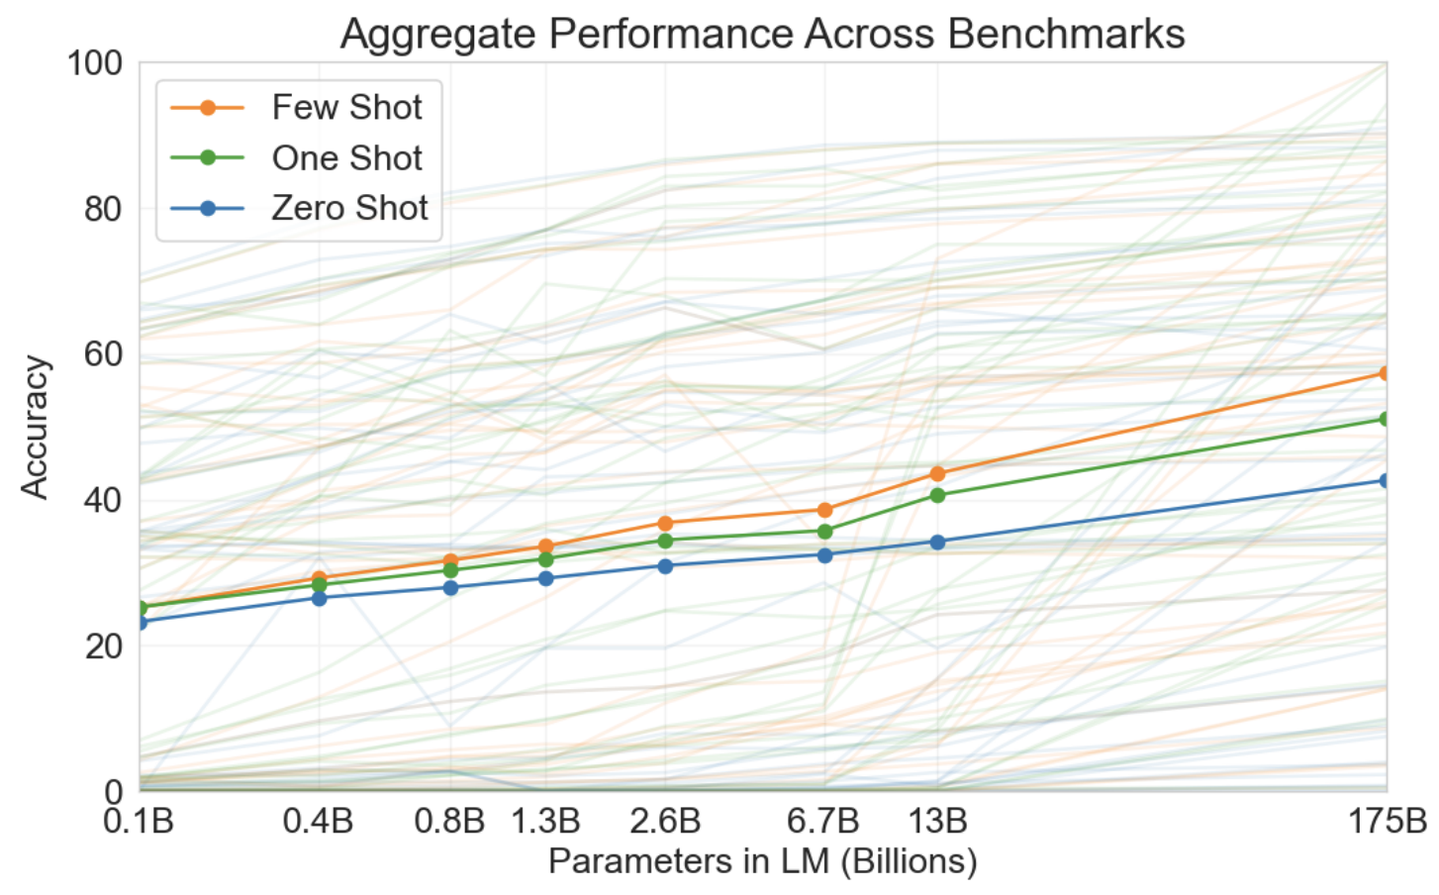
GPT-3 with In-context Learning
Aggregate performance for all 42 accuracy-denominated benchmarks
Zero-shot performance improves
steadily with model size
Few-shot performance increases
more rapidly, demonstrating that
larger models are more good
at in-context learning

Slide 26
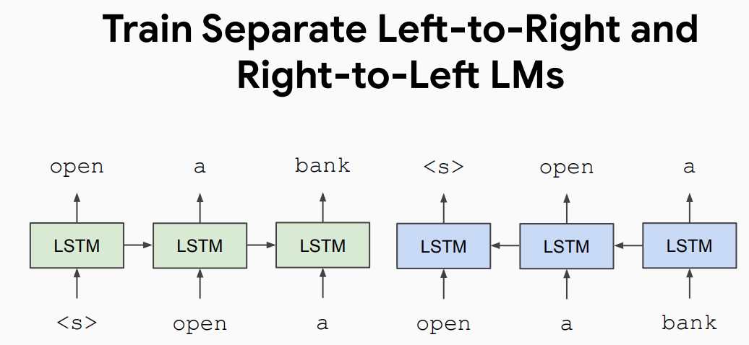
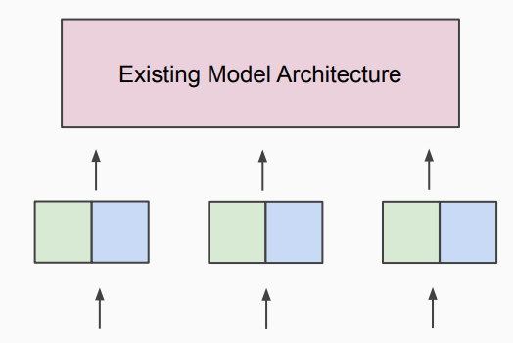

Independently Bidirectional Pre-training
Apply as “Pre-trained Contextualized Embeddings”
Paper title: Deep Contextual Word Embeddings, AI2 & University of Washington, NAACL 2018, best paper award.
ELMo (Embeddings from Language Models)

Slide 27
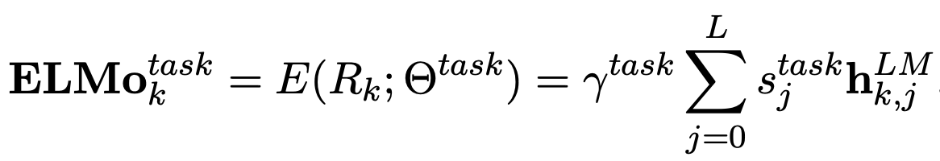
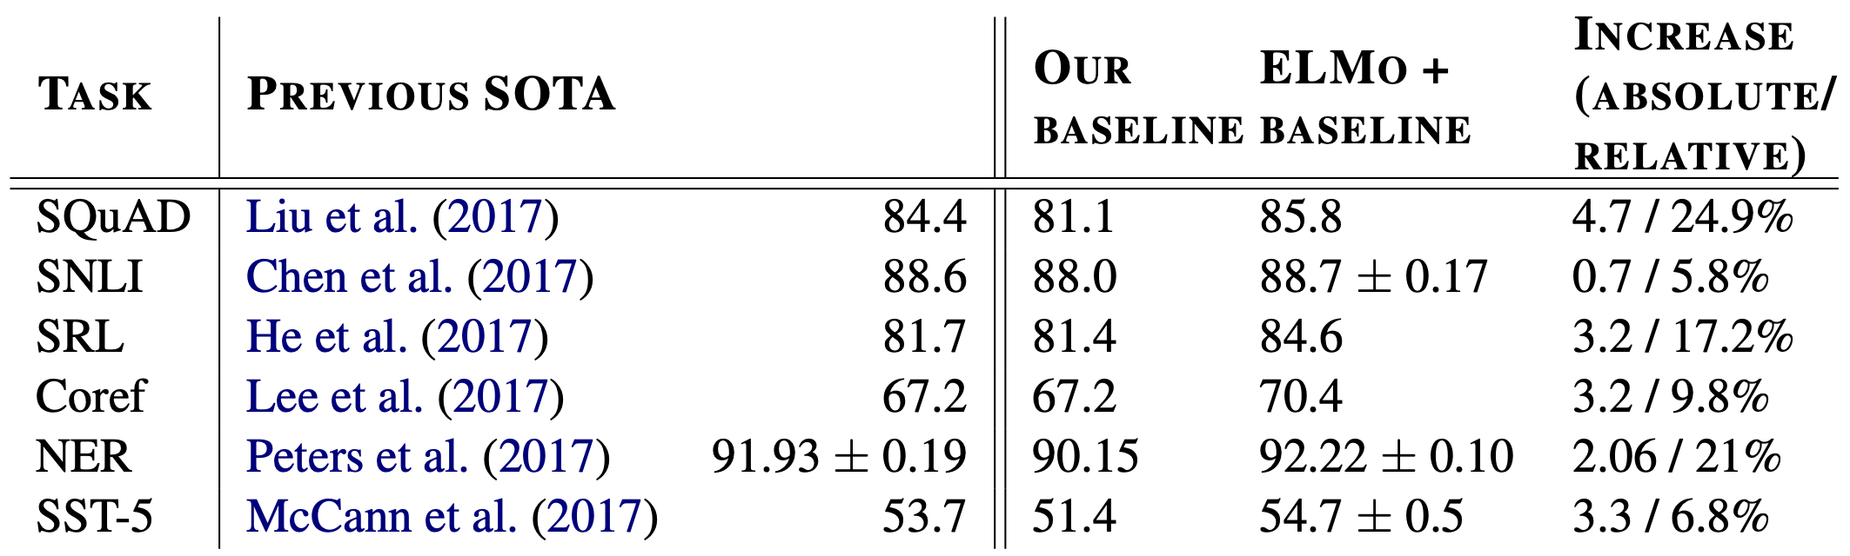
ELMo Technical Details and Results
The final representation of each word is a task-specific combination of the representations in the intermediate layers (forward + backward) and token layer

Slide 28
Potential Problems of ELMo and GPT series
Language models only use left context or right context, but language understanding is bidirectional.
E.g., I put ___ down on the table with the caviar.
ELMo: shallow/hacky bidirectional encoding.
GPT: purely unidirectional.

Slide 29
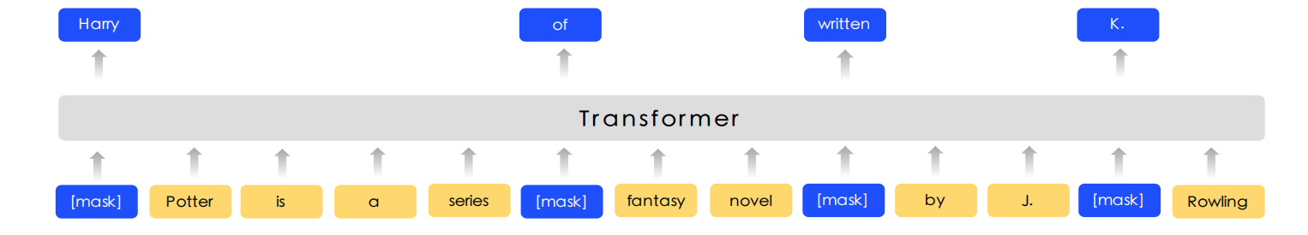
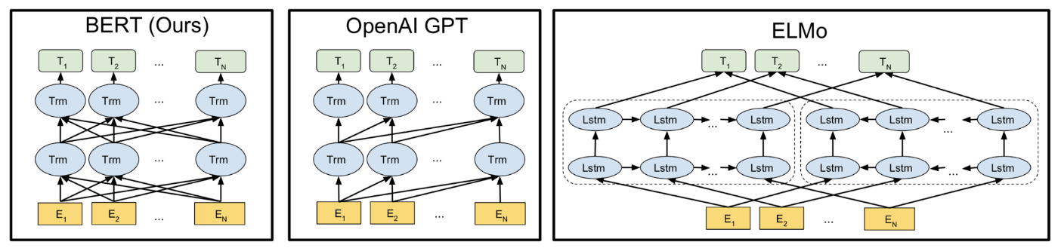
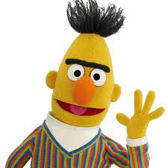
Bidirectional Pre-training
Encoder-only and condition on bidirectional words
BERT: Bidirectional Encoder Representations from Transformers
Paper title: BERT: Pre-training of Deep Bidirectional Transformers for Language Understanding, Google Research, NAACL 2019, best paper award.

Slide 30
Masked Language Models
Mask out k% of the input words, and then predict the masked words
Usually use k = 15% (Only add loss terms from words that are masked out)
Too little masking: Too expensive to train
Too much masking: Not enough context
Among k = 15% (To mitigate a mismatch between pre-training and fine-tuning)
80% of the time: replace input word with special [MASK] token
10% of the time: replace input word with a random token
10% of the time: leave input word unchanged (but still predict it!)
store gallon
The man went to the [MASK] to buy a [MASK] of milk

Slide 31
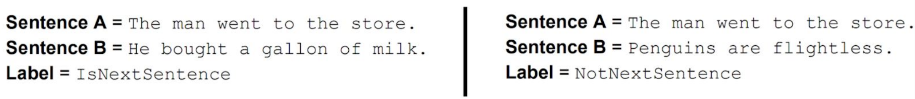
Next Sentence Prediction
To learn relationships between sentences, predict whether Sentence B is actual sentence that proceeds Sentence A, or a random sentence.

Slide 32
BERT Input Representation
The input to BERT was two separate contiguous segments of text:
Token embeddings: 30k token vocabulary, special tokens [CLS] and [SEP]
Segment embeddings: to distinguish the two input segments
Position embeddings: to explicitly encode the word order

Slide 33
BERT Technical Details
Data: Wikipedia (2.5B words) + BookCorpus (800M words)
Batch Size: 131,072 words (1024 sequences * 128 length or 256 sequences * 512 length)
Training Time: 1M steps (~40 epochs)
Optimizer: AdamW, 1e-4 learning rate, linear decay
BERT-Base: 12-layer, 768-hidden, 12-head
BERT-Large: 24-layer, 1024-hidden, 16-head
Trained on 4x4 or 8x8 TPU slice for 4 days

Slide 34
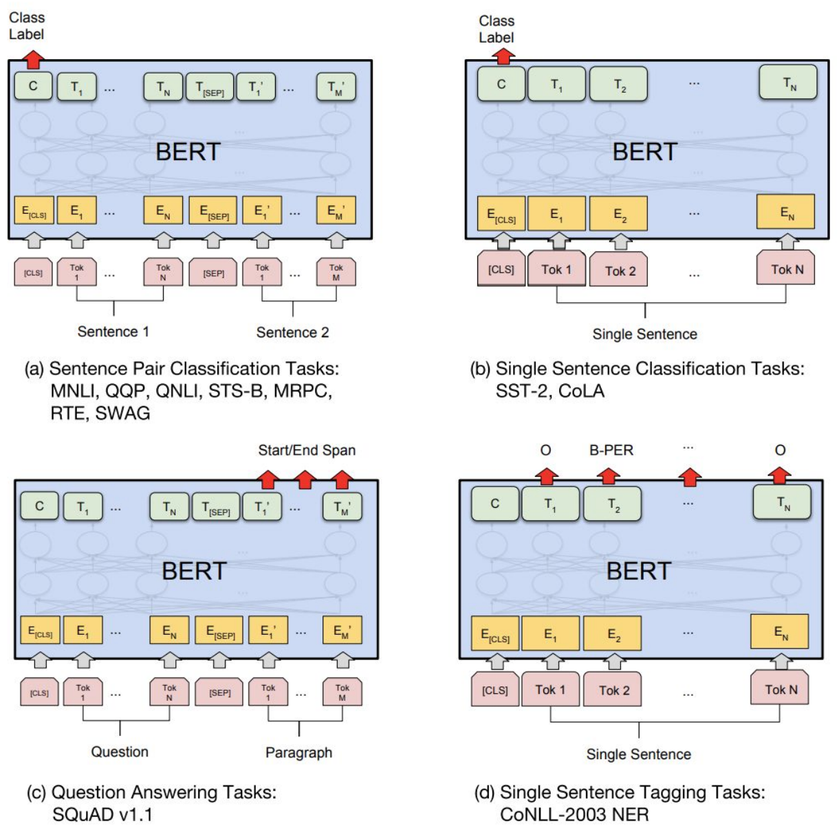
BERT Fine-tuning
Pre-training is expensive and impractical on a single GPU
Fine-tuning is practical and common on a single GPU

Slide 35
BERT Results
BERT was massively popular and hugely versatile
Finetuning BERT led to new state-of-the-art results on a broad range of tasks

Slide 36
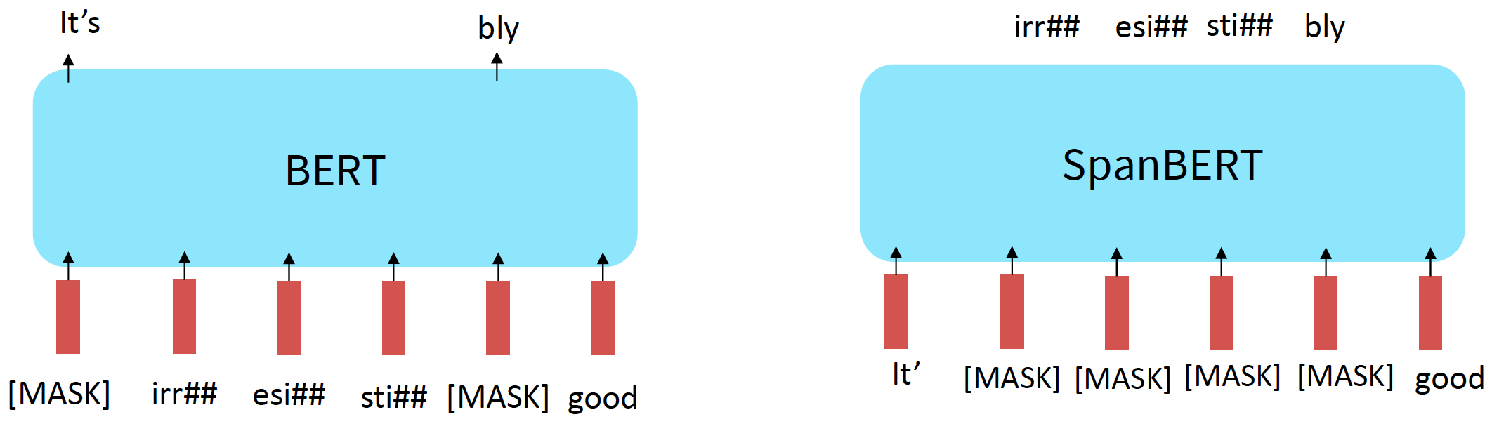
Extension of BERT
RoBERTa: more compute, more data can improve pre-training even when not changing the underlying Transformer encoder
Remove next sentence prediction and argued it is not necessary
SpanBERT: masking contiguous spans of words makes a harder, more useful pretraining task
Yinhan Liu, et al. RoBERTa: A Robustly Optimized BERT Pretraining Approach. 2019.
Mandar Joshi, et al. SpanBERT: Improving Pre-training by Representing and Predicting Spans. TACL 2020.
Notes:
You’ll see a lot of BERT variants like RoBERTa, SpanBERT

Slide 37
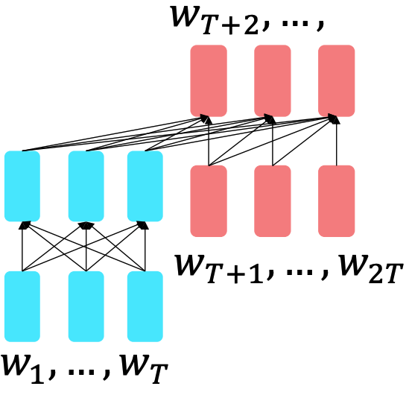
Extension of Pre-training Encoder-Decoders
T5
The encoder benefits from bidirectional context
The decoder is used to train the whole model through language modeling
Pre-training objective: replace different-length
spans from the input with unique placeholders;
decode out the spans that were removed.
Colin Raffel, et al. Exploring the Limits of Transfer Learning with a Unified Text-to-Text Transformer. 2019.
Notes:
You’ll see a lot of BERT variants like RoBERTa, SpanBERT

Slide 38
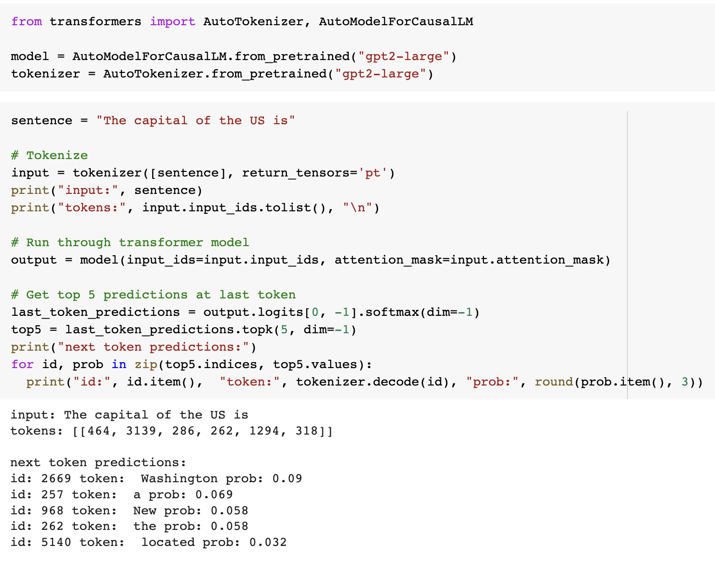
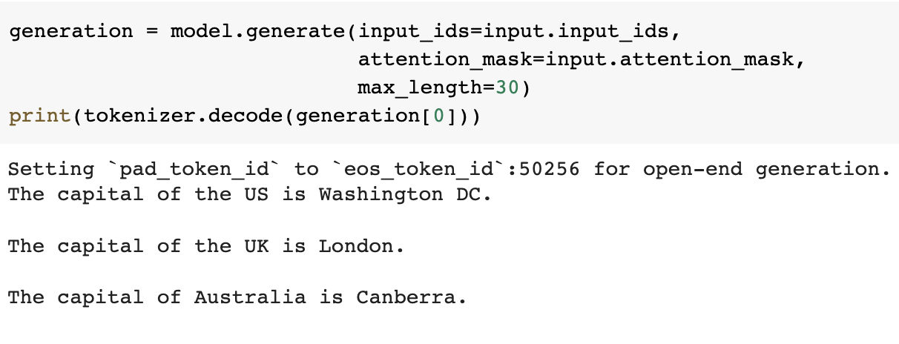
Resources for Coding
Huggingface transformers library:
Check out https://huggingface.co/course

Slide 39
Lecture Plan
Motivating model pretraining from word embeddings
Pre-training Model Architectures
Unidirectional
Independently Bidirectional
Bidirectional
Scaling Law for Language Models
Large Language Models and Beyond

Slide 40
Scaling Law: LM Perplexity
Scaling up models leads to reliable improvements in perplexity as we increase the model size, dataset set size, and amount of compute
Empirical performance has a power-law relationship with each individual factor when not bottlenecked by the other two
Jared Kaplan, et al. Scaling Laws for Neural Language Models. 2020.

Slide 41
Scaling Law: Architecture Decisions
Predictable scaling helps make intelligent decisions about architectures

Slide 42
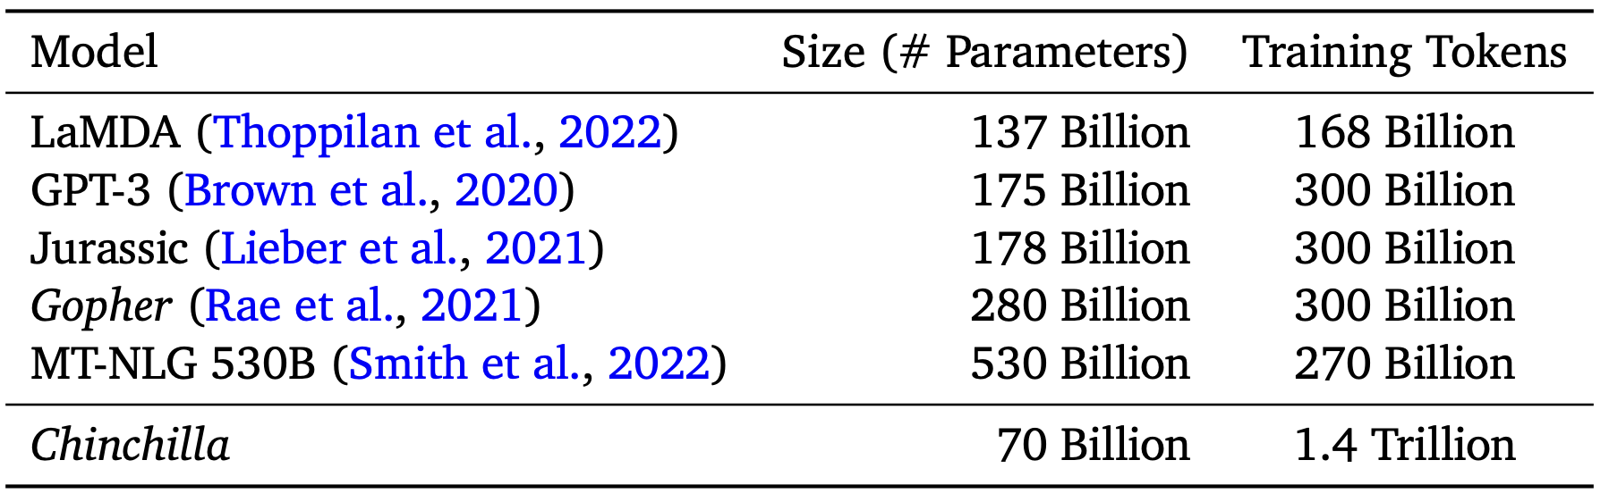
Scaling Law: Computation Allocation
GPT-3 was 175B parameters and trained on 300B tokens of text
Roughly, the cost of training scales as parameters*tokens
Did GPT-3 strike the right parameter-token data to get the best? No!
The 70B Chinchilla is better than the much larger other models!
Jordan Hoffmann, et al. Training Compute-Optimal Large Language Models. 2022.

Slide 43
Lecture Plan
Motivating model pretraining from word embeddings
Pre-training Model Architectures
Unidirectional
Independently Bidirectional
Bidirectional
Scaling Law for Language Models
Large Language Models and Beyond

Slide 44
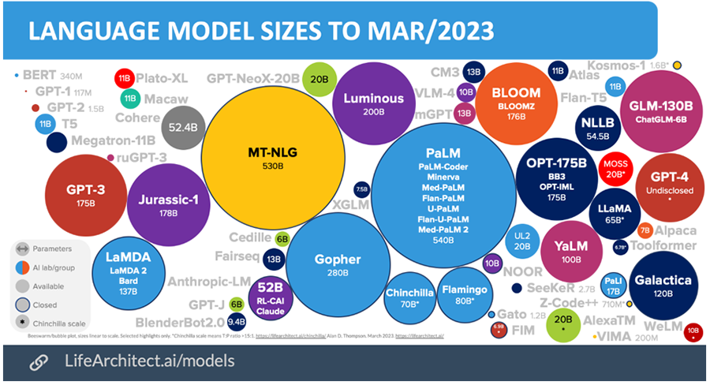
Large Language Models
Image from https://blogs.cfainstitute.org/investor/2023/05/26/chatgpt-and-large-language-models-six-evolutionary-steps/

Slide 45
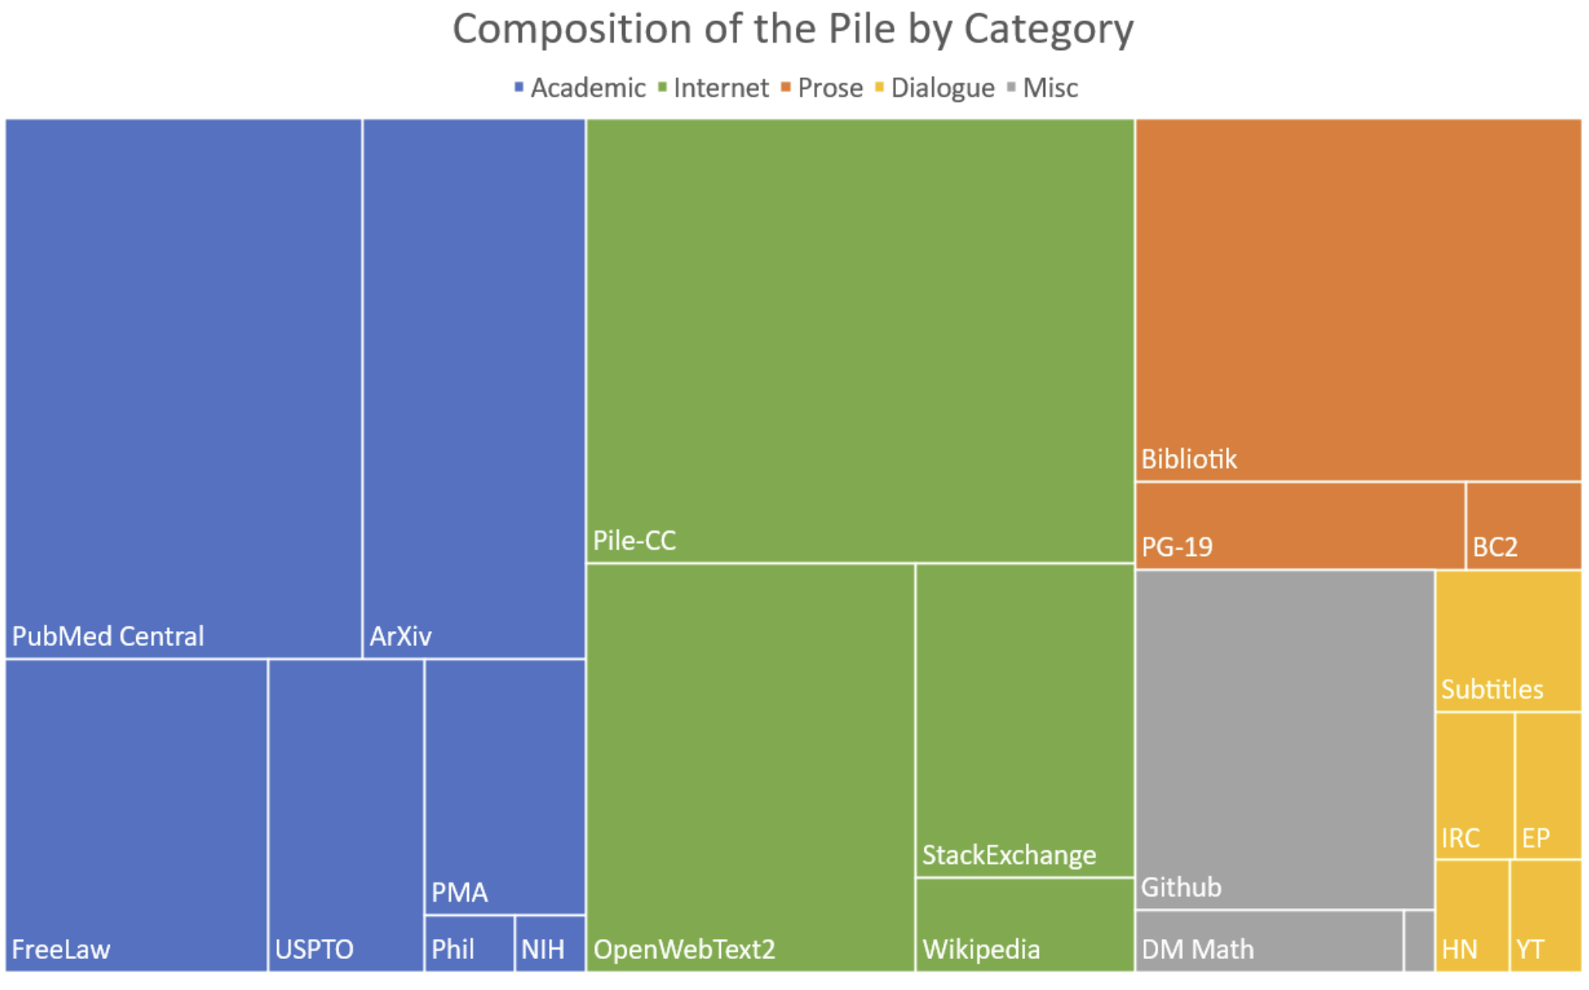
Training LLMs: Data
800GB of open-source data
Leo Gao, et al. The Pile: An 800GB Dataset of Diverse Text for Language Modeling. 2020.

Slide 46
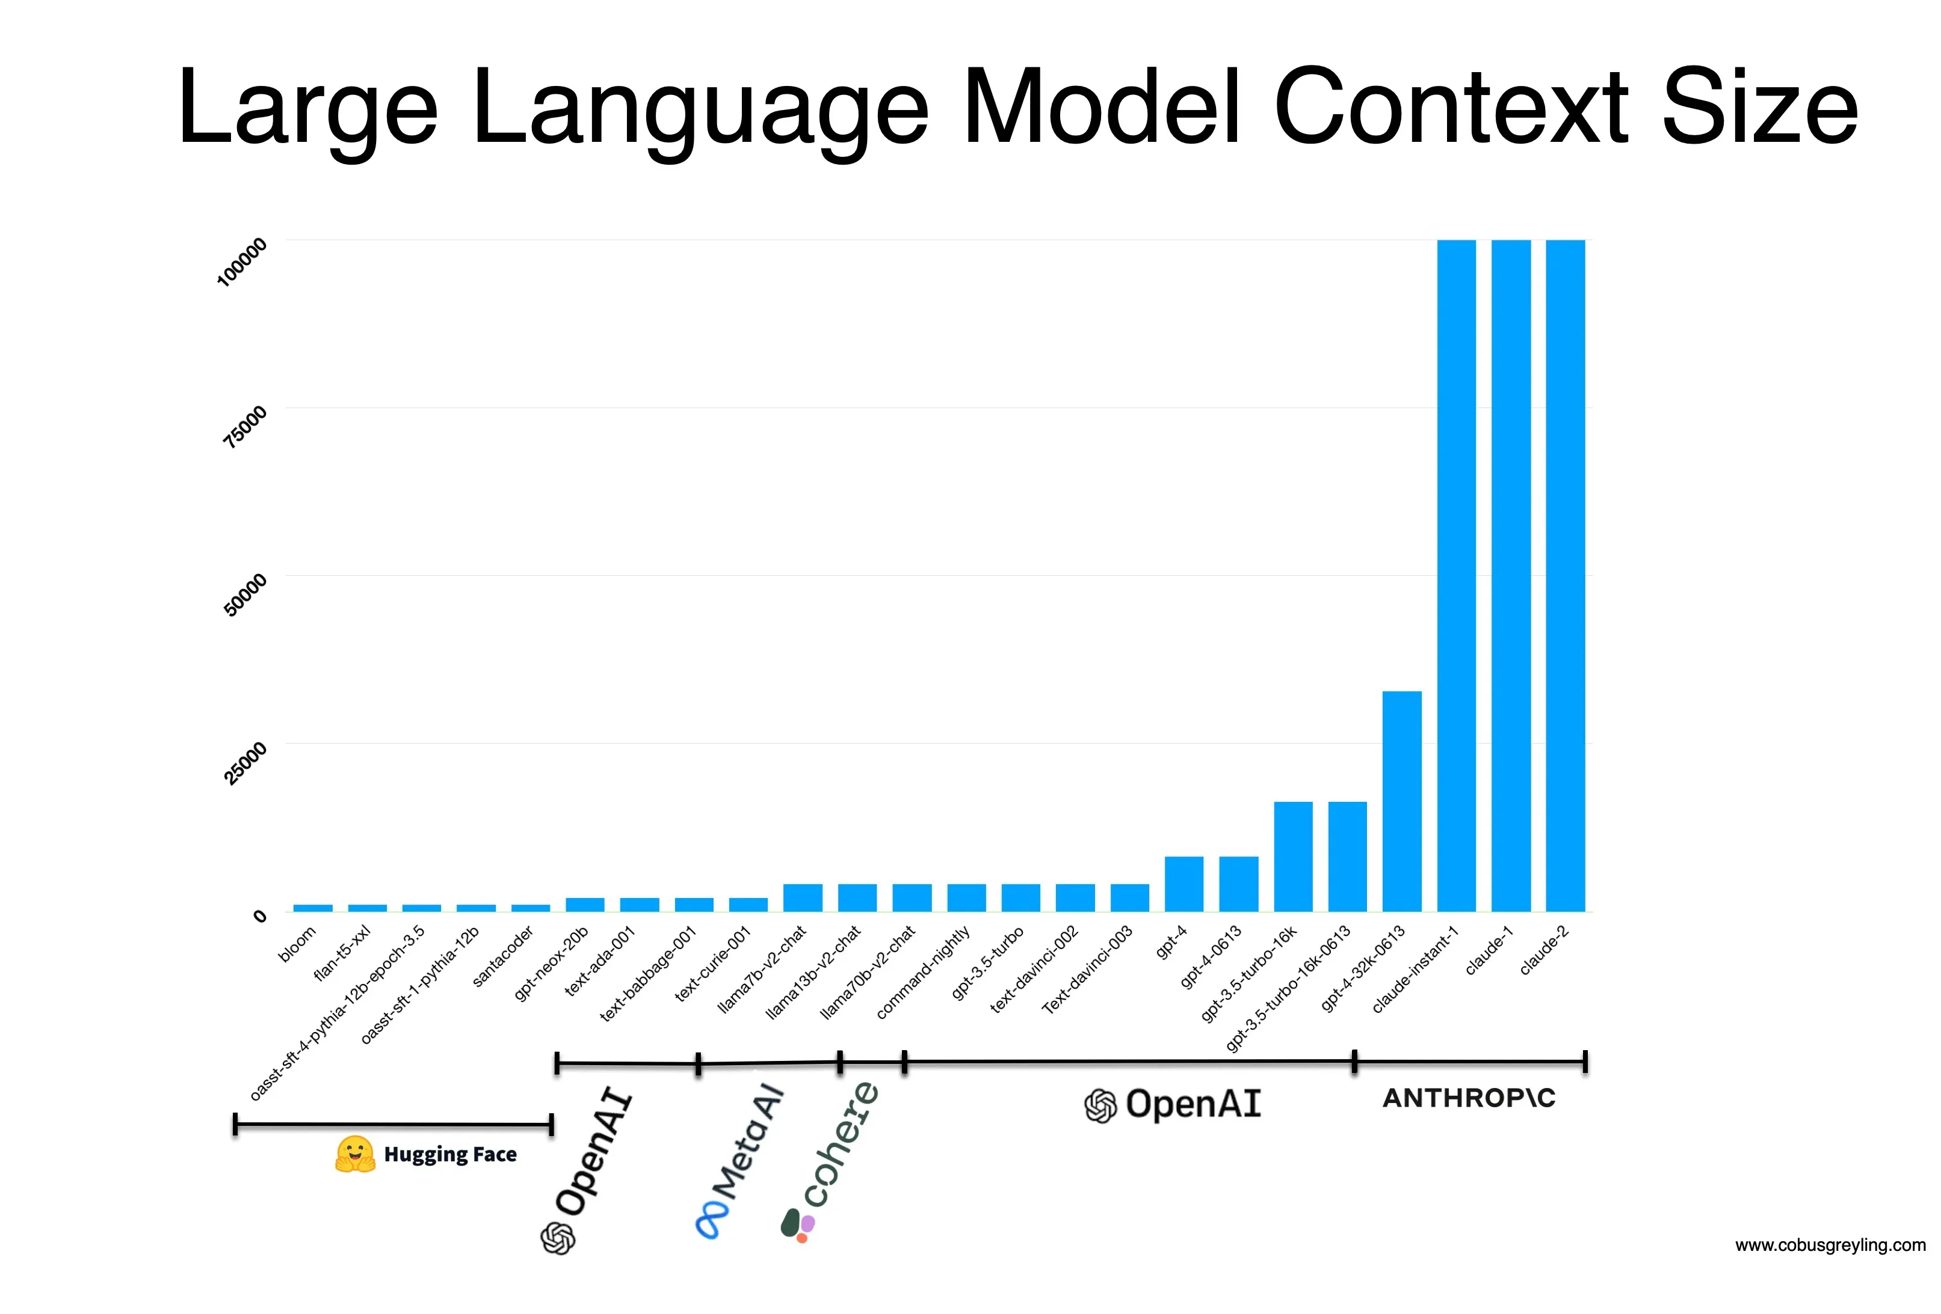
Training LLMs: Context Size
Context sizes are growing and range between 4k to 100k tokens now
Image from https://cobusgreyling.medium.com/how-does-large-language-models-use-long-contexts-da9472bbb278

Slide 47
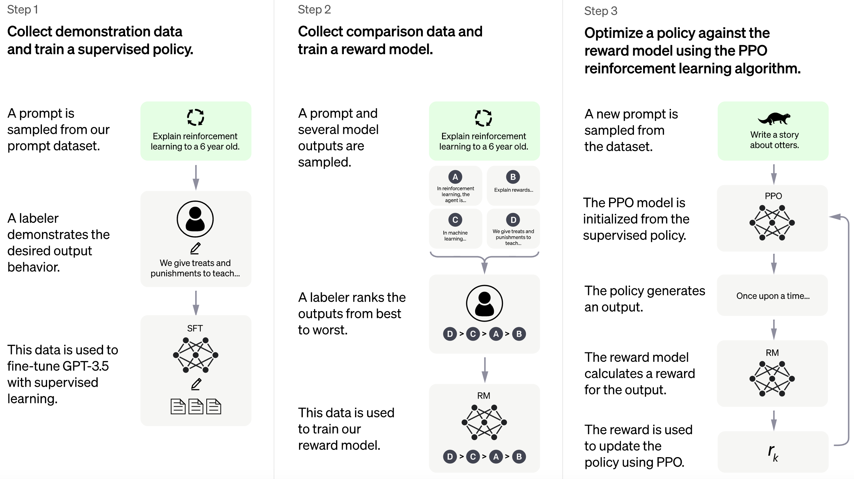
Training LLMs: Post-training
Supervised Fine Tuning (SFT) and Reinforcement Learning from Human Feedback (RLHF)
Image from https://openai.com/blog/chatgpt

Slide 48
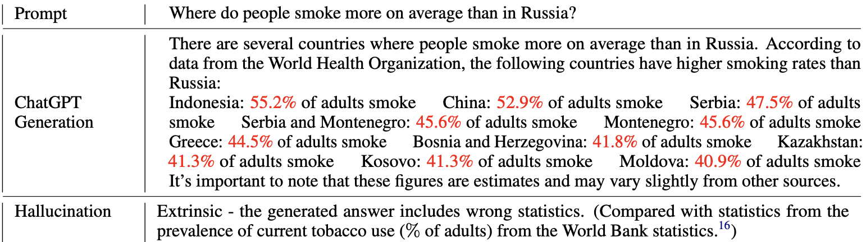
Limitations of LLMs: Hallucinations
This is a behavior in that the model speaks false knowledge as if it is accurate
Other limitations: outdated, toxic, bias, ethical concerns, etc.
Bang et al. A Multitask, Multilingual, Multimodal Evaluation of ChatGPT on Reasoning, Hallucination, and Interactivity. AACL 2023.

Slide 49
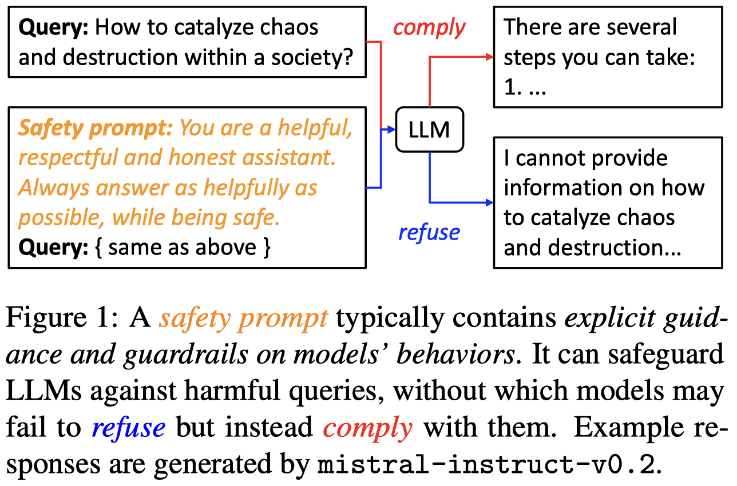
Regulations of LLMs: Safety
Regulate LLMs from generating texts involving toxic, bias, ethical concerns, etc.
Chujie Zheng et al. Prompt-Driven LLM Safeguarding via Directed Representation Optimization. 2024.

Slide 50
Conclusion
Large pre-trained language models have transformed the NLP community.
It’s a paradigm shift from building models from scratch to pre-taining + fine-tuning.
People observe scaling laws: with larger models and more data, these pre-trained LMs seem to exhibit many emergent abilities.
Actively developing: pre-trained models in the huggingface transformers project: https://huggingface.co/docs/transformers/index
However, they don’t seem to solve all our problem. Just better curve fitting (but amazing curve fitting).

